Slide 1
Architecture and Design
SE499: Software Design & Development Project

Slide 2
Understanding Software Architecture
Software architecture refers to the high-level structure of a software system, including the components, interactions, and relationships between them.
It provides a blueprint for the software system, which helps in understanding how the different parts of the system fit together and how they will work together to meet the requirements.

Slide 3
Understanding Software Architecture
Think of it as the 'skeleton' of a software system.
Components: The actual pieces of software (programs, libraries, databases, etc.) that carry out system functions.
Relationships: The interactions and dependencies between these components.
Properties: The individual and collective characteristics of components and their relationships, such as performance, security, and usability.

Slide 4
Why is Software Architecture Important?
Software architecture serves as the foundation of a software system.
Its importance cannot be overstated, and here's why:
Quality Attributes: It defines the system's properties, such as scalability, reliability, and performance.
Risk Management: It helps identify and mitigate potential risks in the early stages of software development.
Communication: It provides a shared vocabulary for stakeholders, aiding understanding and collaboration.
Future-Proofing: It makes future changes and enhancements more manageable by providing a clear structure and roadmap.

Slide 5
Key Concepts in Software Architecture
Components, connectors, and configurations
Architectural styles and patterns
Layers and tiers in architecture

Slide 6
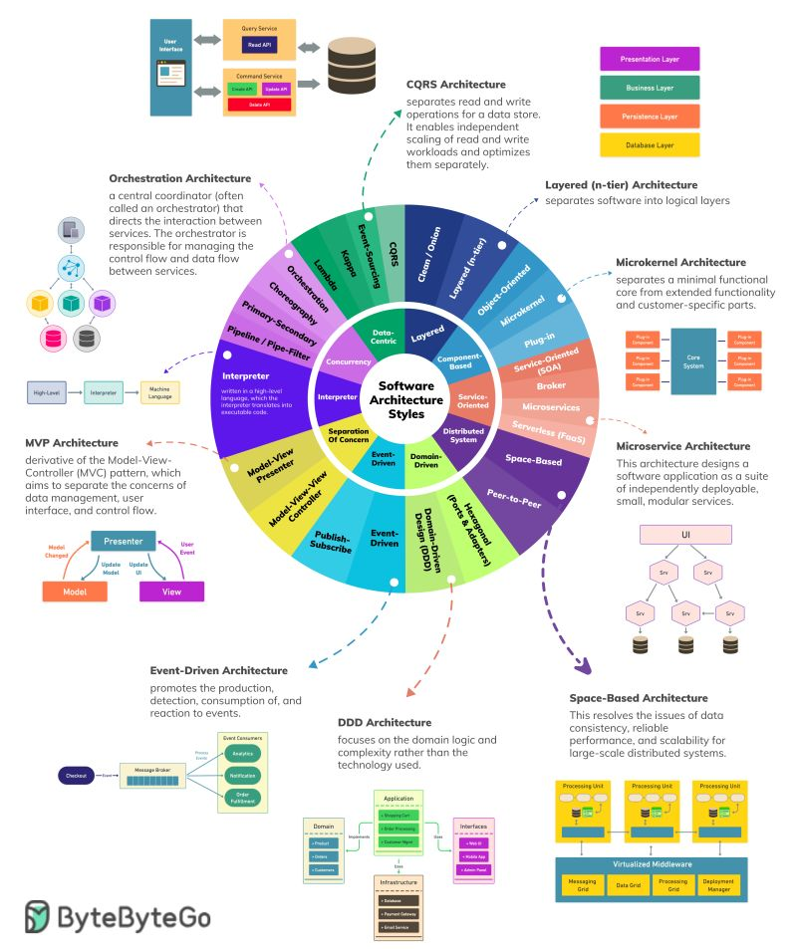

Slide 7
Architectural Design Decisions
How and when to make design decisions
Factors influencing these decisions
Importance of trade-offs in architecture

Slide 8
Common Architectural Styles
Monolithic Architecture
Microservices Architecture
Serverless Architecture
Event-Driven Architecture

Slide 9
Importance of Modularity
Definition of modularity
Benefits of modularity in software design
Strategies to achieve modularity

Slide 10
Software architecture characteristics
Aligning Architecture with Business Goals
Scalability
Maintainability
Extensibility
Flexibility
Performance Efficiency
Security
Usability
Reusability

Slide 11
Understanding Software Design
Software design refers to the process of creating a plan, blueprint, or architecture for a software system.
It involves making decisions about the structure, functionality, and behavior of the system, as well as the algorithms and data structures that will be used to implement it.

Slide 12
Understanding Software Design
Software design is a critical step in the software development process, as it helps ensure that the system is developed efficiently, effectively, and meets the requirements of its users.
It involves a series of activities, including:
Defining the system's requirements and constraints
Creating models, prototypes, and diagrams to represent the system's architecture and functionality
Identifying and evaluating design options and trade-offs
Selecting the most appropriate design solution
Documenting the design in sufficient detail to allow for its implementation

Slide 13
Design Principles
Separation of concerns
Modularity
Abstraction
SOLID principles
Don't repeat yourself (DRY)
KISS (Keep it simple, stupid)
YAGNI (You ain't gonna need it)
Test-driven development (TDD)

Slide 14
Design Principles
Separation of concerns
Modularity
Abstraction
SOLID principles
Don't repeat yourself (DRY)
KISS (Keep it simple, stupid)
YAGNI (You ain't gonna need it)
Test-driven development (TDD)

Slide 15
Design Patterns
Design patterns at the software design level are reusable solutions to common problems that arise during the software design process.
They provide a proven, standardized approach to solving specific design problems, making it easier for developers to create robust, maintainable, and extensible software systems.

Slide 16
Desirable Characteristics of a Design
Minimal complexity
A design should be simple and easy to understand, avoiding unnecessary complexity that can make it hard to maintain and extend.
Ease of maintenance
A design should be easy to maintain and modify, with a focus on making it self-explanatory for maintenance programmers.
Loose coupling
A design should minimize connections between different parts of a program to reduce the impact of changes and improvements.

Slide 17
Desirable Characteristics of a Design
Extensibility
A design should be modular and allow for easy extension and modification without affecting the underlying structure.
Reusability
A design should promote reusability by utilizing modular, flexible, and standardized components.
High fan-in
A design should have a high number of classes that use a given class, indicating good use of utility classes.

Slide 18
Desirable Characteristics of a Design
Low-to-medium fan-out
A design should have a low-to-medium number of classes used by a given class, avoiding high fan-out that may indicate complexity.
Portability
A design should be easy to move to another environment, minimizing environment-specific dependencies.
Leanness
A design should avoid unnecessary parts and code, minimizing the effort required for development, review, testing, and maintenance.

Slide 19
Desirable Characteristics of a Design
Stratification
A design should have clear levels of decomposition, allowing for a consistent view at each level without dipping into other levels.
Standard techniques
A design should utilize established, widely-used techniques and tools to create a familiar and easy-to-understand design.

Slide 20
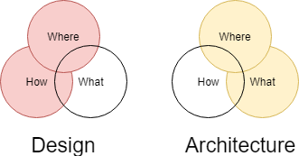
Difference between Architecture and Design
The main difference between software design and software architecture is that software design is focused on the details of the system, while software architecture is focused on the overall structure and high-level design.
Software design typically involves making decisions about the algorithms, data structures, and other low-level details of the system, while software architecture focuses on the overall shape of the system and how it will meet the requirements.

Slide 21
Sprints
In an iterative development approach, the development process is broken down into smaller iterations, with each iteration focusing on delivering a working software system.
Each iteration typically includes a planning phase, a development phase, and a testing phase.
Software design and software architecture play a crucial role in each iteration.

Slide 22
Sprints
During the planning phase of each iteration, the software design and architecture are used to guide the development process, ensuring that the software system being developed meets the requirements and is aligned with the overall vision.
During the development phase, the software design and architecture serve as a blueprint for the developers, providing them with a clear understanding of how the different parts of the system fit together and how they should be implemented.

Slide 23
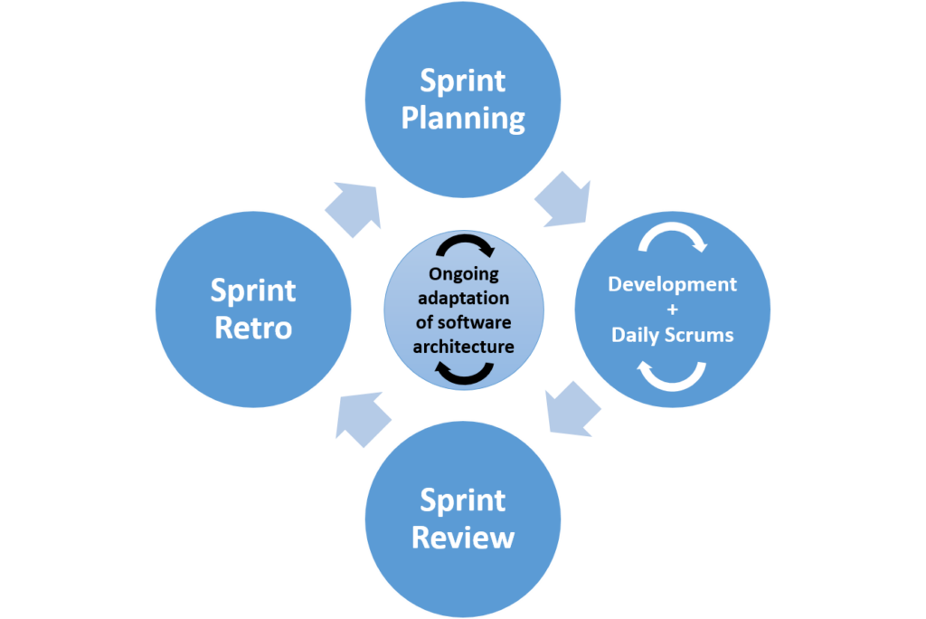

Slide 24
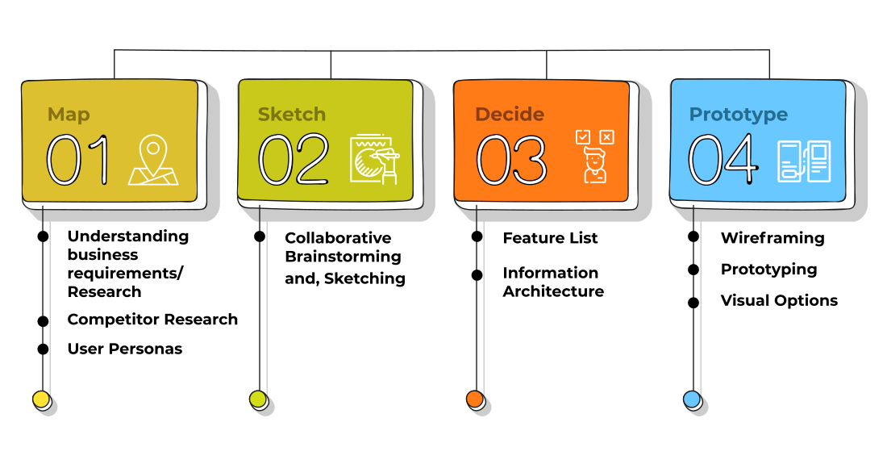

Slide 25
